Slide 1
Digital System Design CE 325 L1 SPRING 2024
Instructor : Dr. Syed Arsalan Jawed
Associate Professor of Practice
arsalan.jawed@sse.habib.edu.pk
Room : W-301
Office Hours : Monday 0930-1030, Wednesday 1430-1530, Friday 0930-1030

Slide 2
Contents of this Lecture
Fundamentals of Sequential Logic
Storage Elements
Latches
Flip-Flops
Associated timing concepts
Buses and Tri-State Devices
State Transition Graphs

Slide 3
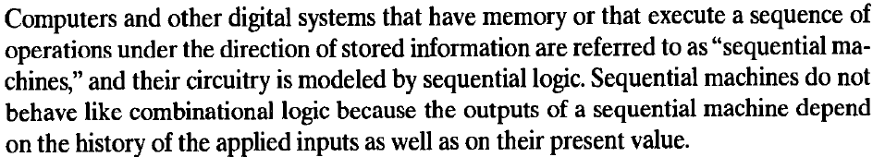
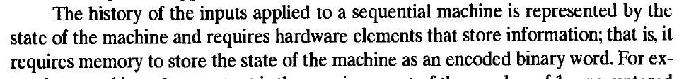
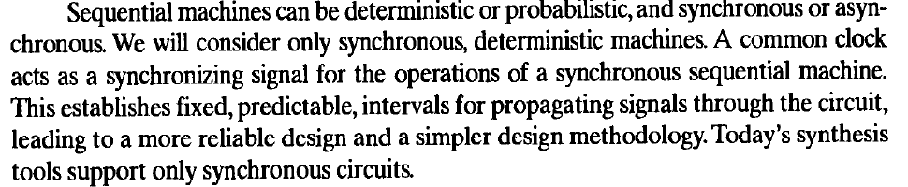
Sequential Logic
Combinational
Sequential
Output =
f
(
In
)
Output =
f
(
In, Previous In
)

Slide 4
Storage Elements
Latches → Level Sensitive, stores data as long as Enable signal is high.
DFF → Edge sensitive, Stores input data only at the edge of clock signal.

Slide 5
Latch versus Register
Latch
stores data when clock is low
Register
stores data when clock rises
D
Q
D
Q
Clk
Clk
Clk
Clk
D
D
Q
Q

Slide 6
Latches

Slide 7
Latch-Based Design
N latch is transparent when φ = 0
P latch is transparent when φ = 1
φ
N
P
Logic
Latch
Latch
Logic

Slide 8
Timing Definitions
CLK
t
Register
t
su
t
hold
D
Q
D
DATA
CLK
STABLE
t
t
c
2
q
Q
DATA
STABLE
t

Slide 9
Characterizing Timing
Register
Latch

Slide 10
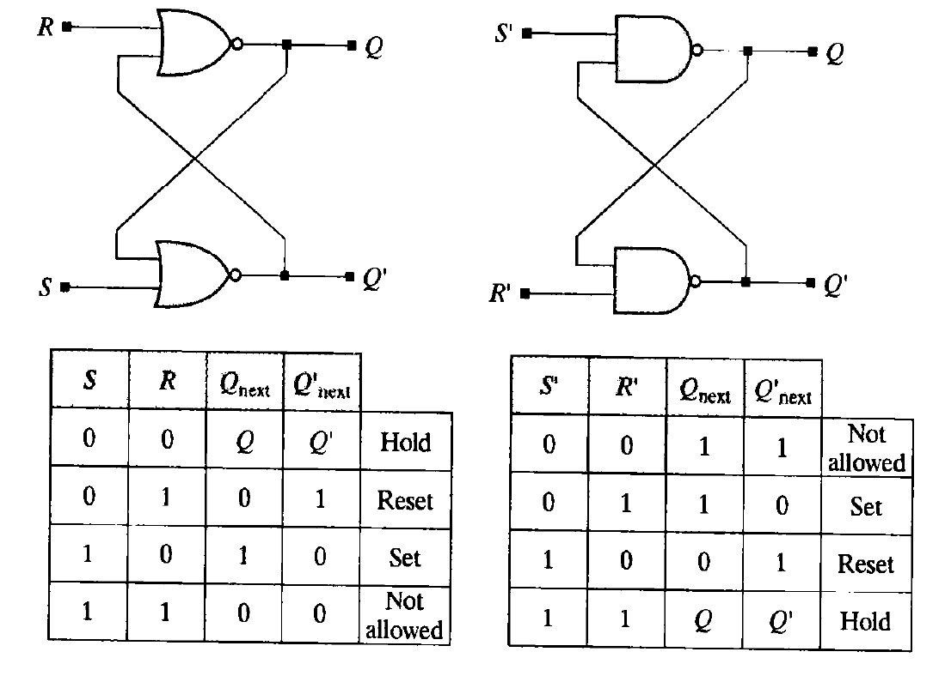
Latches
Why do we have feedback?
Why were did not want feedback in combination circuits?
How to retain memory in general?
→ Feedforward the previous value.

Slide 11
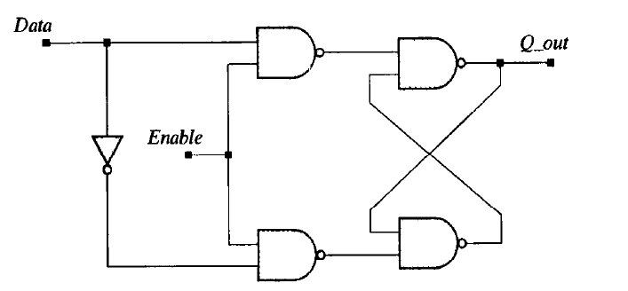
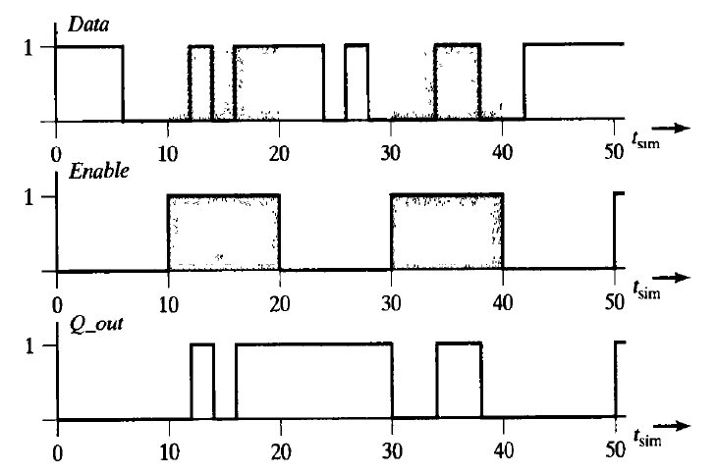
Transparent Latch

Slide 12
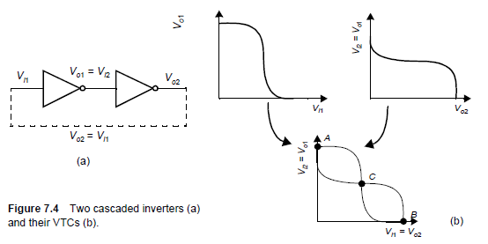
Positive Feedback: Bi-Stability

Slide 13
Meta-Stability
Vi1 is excited by small deviation d
Gain should be larger than 1 in the transition region
Only A and B are stable, C is meta-stable

Slide 14
Mux-Based Latches (now you see why comb feedback is prohibited!!)
Negative latch
(transparent when CLK= 0)
Positive latch
(transparent when CLK= 1)
1
Q
0
Q
D
0
D
1
CLK
CLK

Slide 15
Writing into a Static Latch
Use the clock as a decoupling signal, that distinguishes between the transparent and opaque states
CLK
D
D
CLK
Forcing the state
(can implement as NMOS-only)
Converting into a MUX

Slide 16
Mux-Based Latch

Slide 17
Mux-Based Latch
NMOS only
Non-overlapping clocks

Slide 18
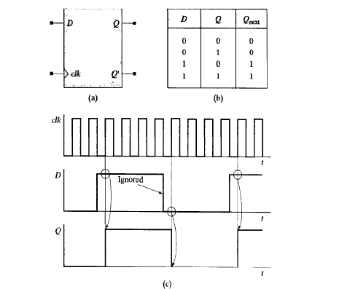
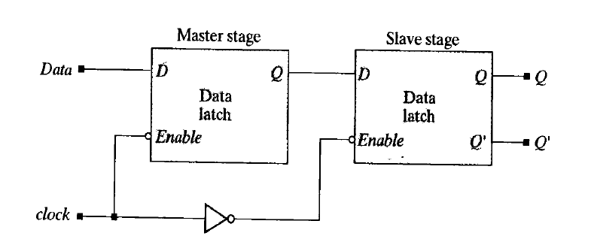
Flip-Flop , D FF, Master Slave

Slide 19
Master-Slave (Edge-Triggered) Register
Two opposite latches trigger on edge
Also called master-slave latch pair

Slide 20
Master-Slave Register
Multiplexer-based latch pair

Slide 21
Clk-Q Delay

Slide 22
Setup Time
Picked up here
Violated here

Slide 23
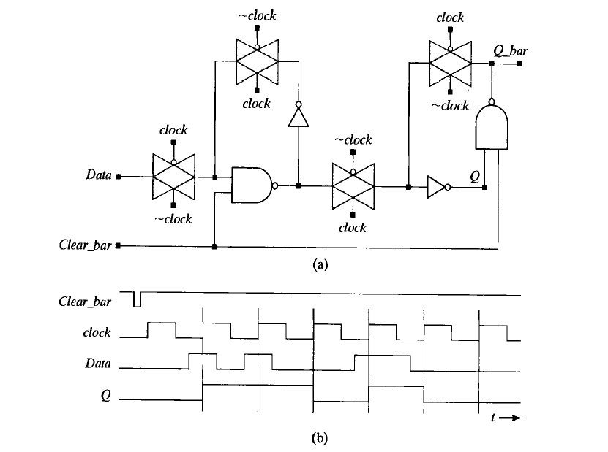
DFF

Slide 24
Toggle Flip Flop
Ask students to suggest an architecture.

